Slide 1
NYPD Capstone Project
By Michael Lee

Slide 2
Background
New York City is home to millions of people and with that comes a large number of crimes each year.
911 calls that come in need to give a certain amount of information in order for there to be an appropriate response.
Because of the nature of crimes, circumstances can change very suddenly and possibly for the worse
As a result, 911 dispatchers have to be able to quickly and efficiently gather information
Every second that a call is taking place is a second that someone is not getting the help they need

Slide 3
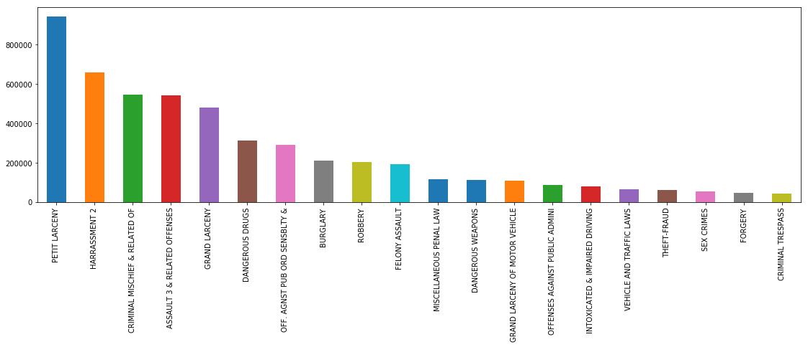
Top 20 most common crimes in New York City
It seems that the most common crimes in the data are petty theft, with more than 800,000 reported, the next most common crime only at around 600,000. The number of each crime decays slowly as the graph goes from most to least occurring in the graph.

Slide 4
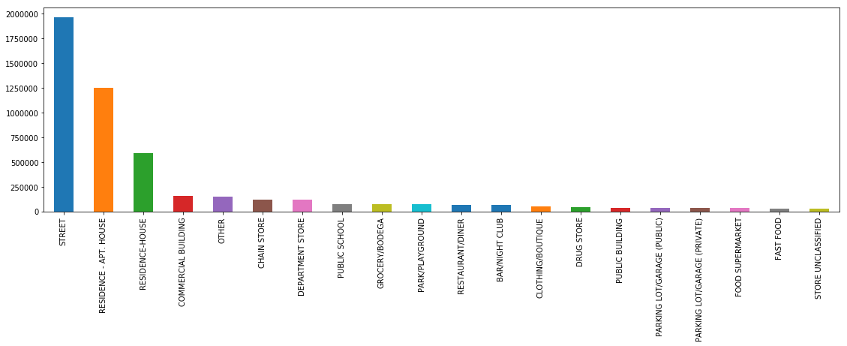
Type of Location Crime Occurred
This graph shows the number of crimes reported and what type of location that it occurred. As shown, the vast majority of crimes are outside on the street, or in a residence. With the types of crimes that are seen in the previous graph, and the amount of people either walking around outside or in their own homes, it makes the most sense that these are the most common locations for the scene of a crime.

Slide 5
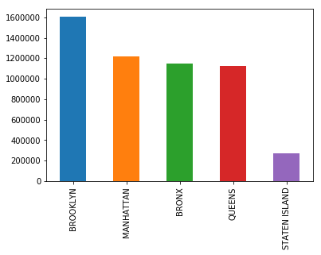
Crimes by Borough
The most crimes in the city are located in Brooklyn
Manhattan, Bronx and Queens all have similar number of crimes reported
Staten Island is shown to have the least. Intuitively this would make sense since Staten Island has lowest population out of the 5 boroughs.

Slide 6
Prediction Model for NYPD Calls
The model uses data obtained from the NYC Open Data Program.
Link: https://data.cityofnewyork.us/Public-Safety/NYPD-Complaint-Data-Historic/qgea-i56i
The model uses the Gradient Boosting Classifier function
Feature engineered to create a binary target column for whether the crime called in is dangerous or not, and used the crime description column to create it
Limited the data in the model to the top 10 crimes in the dataset, and created a new dataset with the same number of rows for each crime
Performed with a precision score of 67 percent and recall of 68 percent after tuning hyperparameters

Slide 7
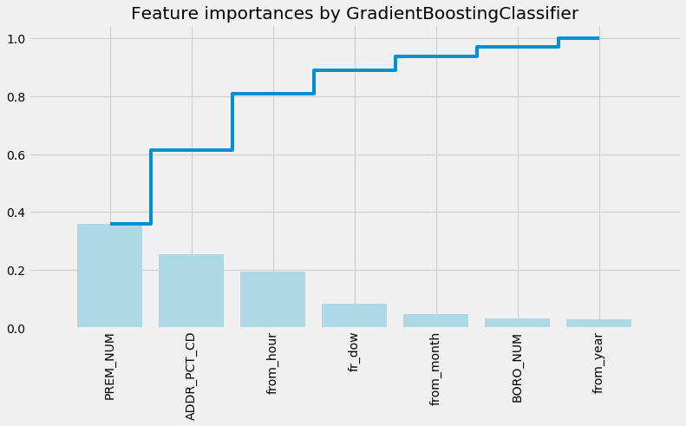
Features in the Model
PREM-NUM: This feature contains what type of location a crime occurred.
ADDR_PCT_CD:The police precinct that a crime was closest to, used as a location estimator
From_():The hour, day of week, month or year that the call was received by the NYPD

Slide 8
Model Critique and Possible Improvements
The model was only able to use a portion of the data, so if more rows could be used along with different crimes other than just the top 10 most common would be more useful.
Whether the type of crime is dangerous or not is highly subjective, and due to the nature of crimes, may not always be one or the other.
The use of voice data as a call is received in real-time, importantly the tone of voice, would be a very powerful tool to add to the model in order to increase its prediction power.
The use of trends in criminal activity from past 5-10 years could also be potentially useful to create a more practical model.

